Slide 1
”HKömys” SITE CONCEPT
Elizaveta Petrova (a1504523)

Slide 2
conceptual plan
Site “Hkomys” offers different kinds of jewellery.
Target group – women 20-30, students, graduates wear on special events or daily (theatre, senior party, wedding, presentation, club) around the world but mainly in Moscow, Helsinki.
The function of the site: Here you can see different range of items and order them. There is already ready market and clients. There is no yet any such website which sell yakut national earrings.

Slide 3
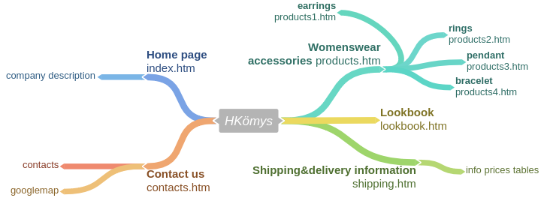
Site page map
pages on the site: Home, Accessories, Shipping info, lookbook, contacts.
Using Big-Menu or Small-menu for mobile version you can navigate through all pages.
For womenswear accessories create side menu in order to filter content.(earrings, rings, bracelets,…)

Slide 4
Manuscript
A sketch of the page layout:
Images: logo, delivery1, earrings#, bracelet#, ring#, pendant#, lookbook#.
Navigation: Small and big menu on top for mobile and pc version, side menu for filter.
(possibility to add more things like jew’s-harp, fossil ivory items)
1)Logo
2)navigation
3) Page title
4)Pics and description
Company Description
earrings
pendant
rings
bracelet

Slide 5
Manuscript
Page: index.htm, HKömys home page
Page idea: business idea and links to other pages.
Background: background2.jpg
Module | Content
1) Logo | logo4.png
2) Navigation | Home – Wowenswear Accessories -Shipping information – lookbook -contacts
3) Page title | Welcome! (h1)
4) Pics and description | Here you can order different kinds of traditional jewellery. earrings20.jpg hkomys@gmail.com 00410 Helsinki

Slide 6


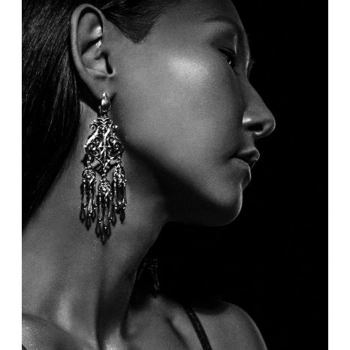
graphic plan
General description: Responsive
Component dimensions and locations
Page width 75%
Page is centered
Font is verdana
Logo size: 600x100 px
background-color: white
border: 20px solid
#B4A9BB
Home
Womenswear Accessories
Shipping info
Lookbook
Contacts
Hover background-color: #B4A9BB
Welcome!
Here you can order different kinds of traditional jewellery.
font-size: 20px
40%

